Slide 1
PENULISAN PROPOSAL
Dr. Yus Sholva Riza, ST, MT.

Slide 3
How to find an idea…..

Slide 4
Ask your self: your interest ..your passion

Slide 5
Goes to Library: Good idea

Slide 6
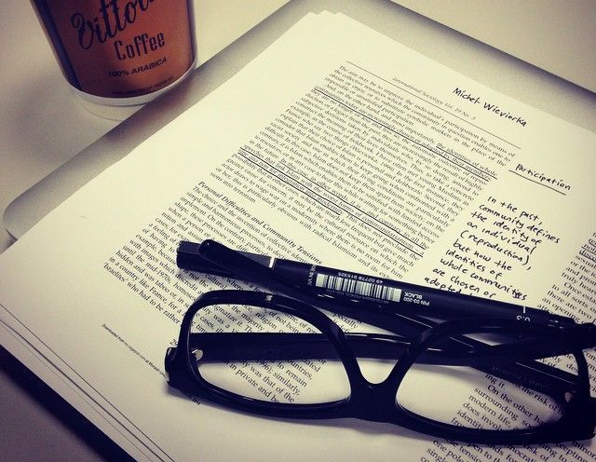
The Journal article: new or old one, …any is fine

Slide 7
Scientific magazine or web: an idea can come from any where …

Slide 8
Keep update: ..for the latest issues
Notes:
Ask your self: your interest ..your passion
Library: Good idea
Journal: New/old one, any is fine
Scientic magazine or web: Idea can come from any where
Keep update for latest issue
Discuss with The Older Student
Sit in or visit in or conference: your field of interest
Forget about being a Top Guy or get cumlaude grade
Wanna be a graduate student: linearity
Have an idea: Ask your supervisor
Join with your supervisor project

Slide 9
Discuss to “the senior” the older student
Notes:
Ask your self: your interest ..your passion
Library: Good idea
Journal: New/old one, any is fine
Scientic magazine or web: Idea can come from any where
Keep update for latest issue
Discuss with The Older Student
Sit in or visit in or conference: your field of interest
Forget about being a Top Guy or get cumlaude grade
Wanna be a graduate student: linearity
Have an idea: Ask your supervisor
Join with your supervisor project

Slide 10
Sit in or visit in or conference: your field of interest
Notes:
Ask your self: your interest ..your passion
Library: Good idea
Journal: New/old one, any is fine
Scientic magazine or web: Idea can come from any where
Keep update for latest issue
Discuss with The Older Student
Sit in or visit in or conference: your field of interest
Forget about being a Top Guy or get cumlaude grade
Wanna be a graduate student: linearity
Have an idea: Ask your supervisor
Join with your supervisor project

Slide 11
Forget about: being a Top Guy or Cum Laude grade
Notes:
Ask your self: your interest ..your passion
Library: Good idea
Journal: New/old one, any is fine
Scientic magazine or web: Idea can come from any where
Keep update for latest issue
Discuss with The Older Student
Sit in or visit in or conference: your field of interest
Forget about being a Top Guy or get cumlaude grade
Wanna be a graduate student: linearity
Have an idea: Ask your supervisor
Join with your supervisor project

Slide 12
Want to be a graduate student: consider the linearity…
Notes:
Ask your self: your interest ..your passion
Library: Good idea
Journal: New/old one, any is fine
Scientic magazine or web: Idea can come from any where
Keep update for latest issue
Discuss with The Older Student
Sit in or visit in or conference: your field of interest
Forget about being a Top Guy or get cumlaude grade
Wanna be a graduate student: linearity
Have an idea: Ask your supervisor
Join with your supervisor project

Slide 13
Have an idea: Ask your supervisor…
Notes:
Ask your self: your interest ..your passion
Library: Good idea
Journal: New/old one, any is fine
Scientic magazine or web: Idea can come from any where
Keep update for latest issue
Discuss with The Older Student
Sit in or visit in or conference: your field of interest
Forget about being a Top Guy or get cumlaude grade
Wanna be a graduate student: linearity
Have an idea: Ask your supervisor
Join with your supervisor project

Slide 14
Join in your supervisor’s project
Notes:
Ask your self: your interest ..your passion
Library: Good idea
Journal: New/old one, any is fine
Scientic magazine or web: Idea can come from any where
Keep update for latest issue
Discuss with The Older Student
Sit in or visit in or conference: your field of interest
Forget about being a Top Guy or get cumlaude grade
Wanna be a graduate student: linearity
Have an idea: Ask your supervisor
Join with your supervisor project

